Slide 1
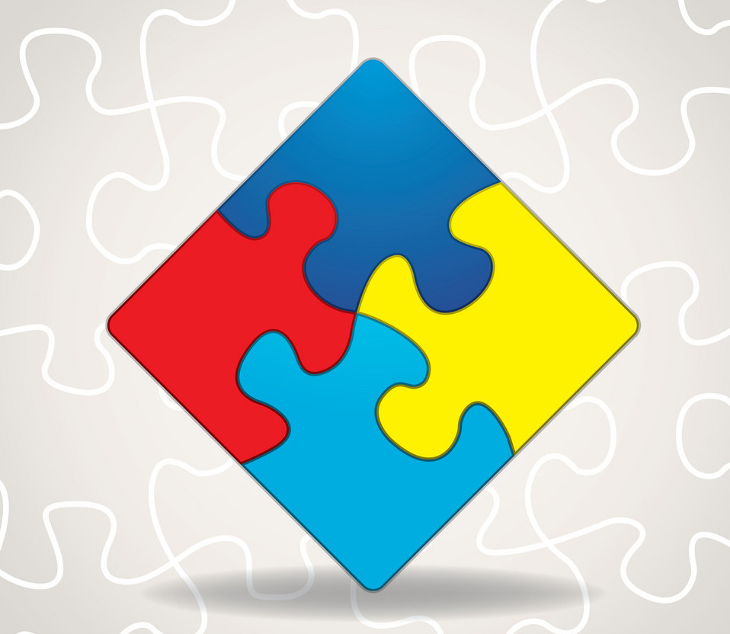
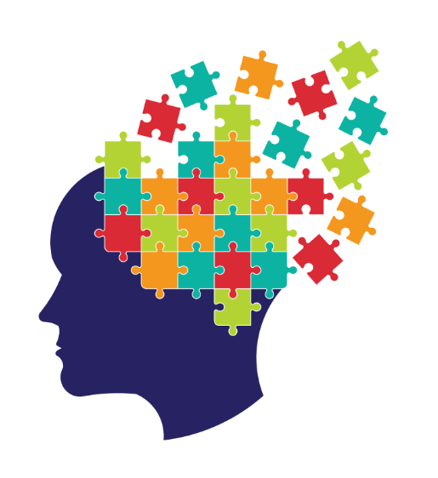
Sensory-Motor exercises
Training the Brain Through Physical Stimulation

Slide 2
Introduction
The body and brain are a reciprocal feedback system. Growth of one is dependent on the other.
The growth is created by stimulation by the environment
You will retrain the brain through physical and sensory stimulation
None of these activities will harm a child. There are no negative side effects.
Most of the exercises are divided by function level – Level 1 is the most severe weakness, Level 2 is moderate, and Level 3 is the least severe. You will start your child out at his or her current level.
When the child can achieve each exercise without fault at Level 3 for four sessions in a row, you will have successfully completed the program.

Slide 3
Exercise Basics
Frequency over intensity- changes will occur with more frequent, less intense exercises over a long period of time
Movement must be slow and purposeful
Add some sort of mental activity (jumping rope, reciting the alphabet, etc.)
Exercises should be done a minimum of 3-4 times a week
Do the program after school and before dinner- fatigue can be a negative factor if you do it later
Stay motivated and positive
Give it time
Maintain a positive mind-set

Slide 4
Diaphragmatic Breathing
Level: All
Have your child stand straight and tall, arms against their sides
Have them inhale slowly and count the seconds
They should exhale twice as slowly
Repeat 3-5 times
Goal is to slowly increase the time on both the inhalation and exhalation

Slide 5
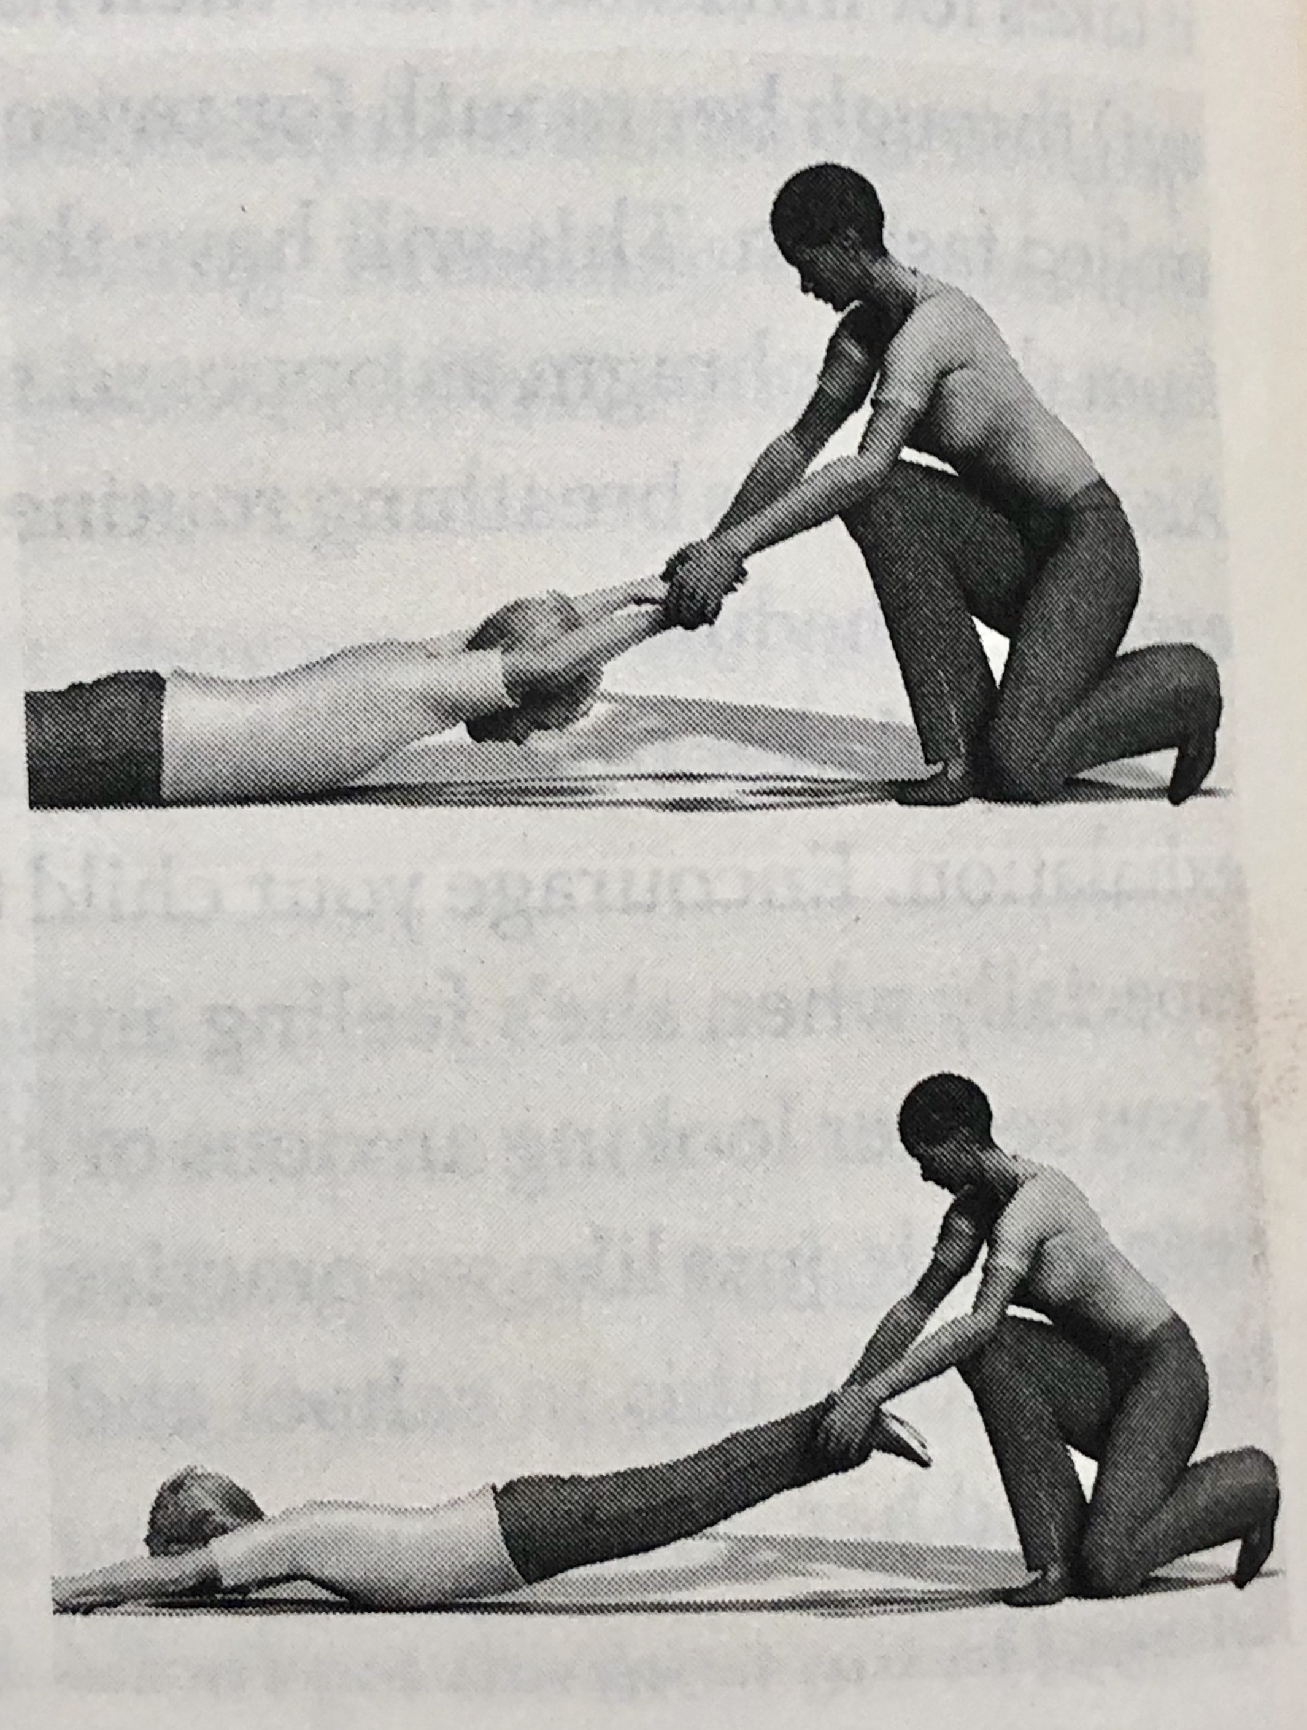
Proprioceptive Joint Distraction Exercise
Level: All
Have your child lay on a towel or mat facedown with feet extended and arms straight out next to their head
Grasp your child’s wrists and gently pull, holding for 5 seconds before releasing
Repeat 6 times, waiting 5-10 seconds between each stretch
Grasp your child’s ankles and gently pull, holding for 5 seconds before releasing
Repeat 6 times, waiting 5-10 seconds between each stretch
Caution: Pull gently and slowly. Be careful not to stretch forcefully.

Slide 6
Smell Distance Detection Exercise
With your child blindfolded, ask him to press one nostril closed
Hold the first canister about 12 inches from the nostril, move the canister closer if they can’t detect the smell
When they can smell the scent, ask them to name the scent and give them 3 chances to guess the scent
If it is difficult for them, offer three or four choices
If your child achieves the goal with no mistakes for four days in a row, move on to the next level
For right hemisphere weakness: Stimulate right nostril only. Use strong scents such as black pepper, burnt wood, coffee, eucalyptus, and fish oil.
For left hemisphere weakness: Stimulate left nostril only. Use pleasant scents such as apple, banana, cherry, chocolate, and grape.
Level 1: Three correct smells in a row
Level 2: Six correct in a row
Level 3: Nine correct in a row

Slide 7
Vision: Pencil Push-Up Exercise
Do this if the child showed an inability to cross her eyes to the proper distance
Exercise:
Hold a pencil approximately 18 inches in front of her nose
She should be able to focus and see only one pencil at this distance.
If she sees two, move the pencil back inch by inch until she sees only one.
Slowly bring the pencil toward the nose and tell her to let you know the moment she sees the pencil double. Stop and note the distance. Ask her to try as hard as possible to see it as one pencil again. If she can do this, continue to slowly bring the pencil closer to her nose until she tells you that she sees two images again.
Repeat the entire exercise three times it she does not get too tired
Level 1: Do the exercise fully one time.
Level 2: Do the exercise fully two times.
Level 3: Do the exercise at least three times.

Slide 8
Vision: Fast Tracking Exercise
Right hemisphere deficiency: Exercise the right eye.
Left hemisphere deficiency: Exercise the left eye.
The goal was to determine if the eyes were not moving quickly enough, which resulted in either over shooting or undershooting a moving target (your finger).
You will use fast movements and concentrate these movements on the slower side - that is, the side that overshoots the target.
You will exercise both eyes, only you will be exercising the weak side more often.
In a series of ten movements, three will be to the strong side and seven to the weak side. Make sure that the child moves both eyes quickly to both sides. This is enough of a balance to keep the child guessing, but it will work one side significantly more than the other.
Have the child stand or sit, relaxed, head straight and facing you at eye level. Tell him that you are going to wiggle a finger and you want him to look at your finger quickly without moving his head.
Tell him when you say “Okay" he should look back at your nose. For a child with a right brain weakness wiggle your right finger seven times and your left finger three times. Do it vice versa for a left hemisphere weakness.

Slide 9
Vision: Slow Tracking Exercises
Right hemisphere weakness: Exercise right direction only
Left hemisphere weakness: Exercise left direction only
Stand in front of your child and move a few steps from center and farthest from the side that your finger will start. (If you are working with the right brain, you will move to the left of center.)
You want to stand as far away as possible as the eyes can turn. Hold up your index finger or a pencil about 12 inches back from her face and ask your child to keep her head straight and turn her eyes toward your finger. Tell her she should not move her head. Ask her to follow your finger or the pencil with her eyes as you slowly move from far left to far right.
Ask the her to close her eyes. Go back to your original position. Ask her to to open the eyes and locate your finger.
Repeat this for 10 times.
Level 1: Only slow movements
Level 2: Slow and fast tracking
Level 3: Do all tracking movements fully two times

Slide 10
Light-Blocking Activity: Eye Patch
Level: 1
Have your child wear the patch over the eye that is on the side of the weak hemisphere. Start with 30 min and progress to 2 hours of continual use. As the child's tolerance increases, have him wear it to watch TV or play on the computer. Then have the child wear the patch to read.

Slide 11
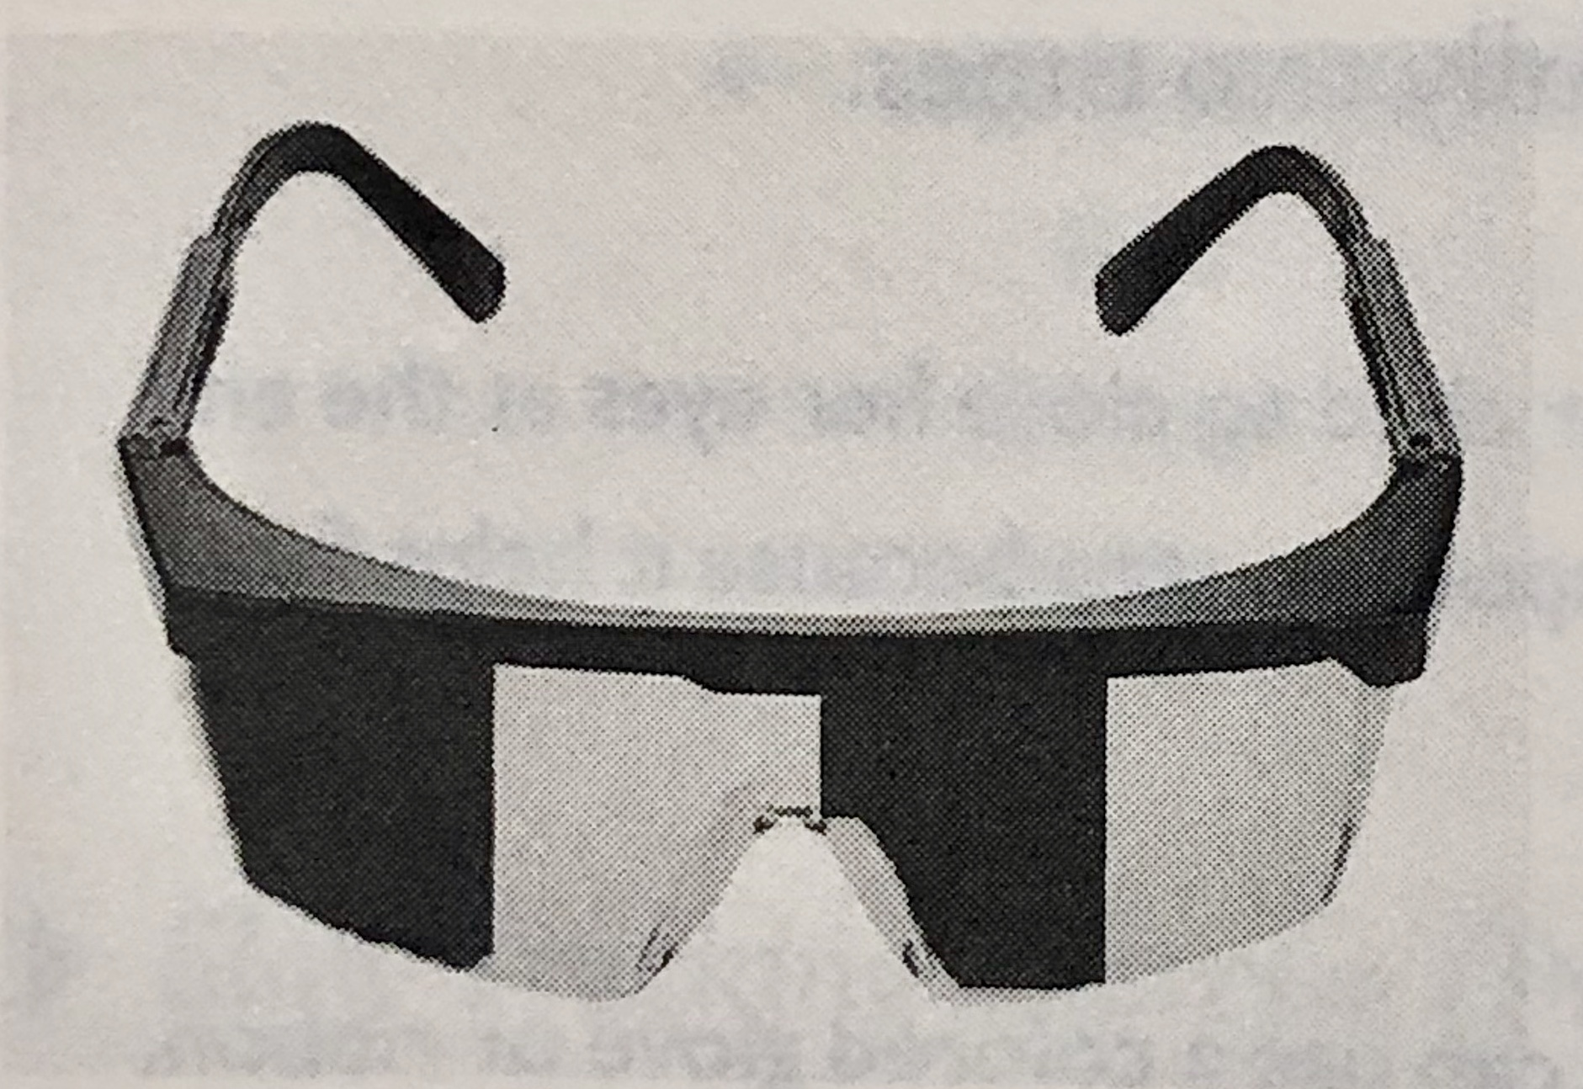
Light-Blocking Activity: Blocking Glasses
Level: 2
Right brain deficiency: Block right half of both lenses.
Left brain deficiency: Block left half of both lenses.
Hemifield glasses are special lenses that can be manipulated to partially block light from entering the retina. They are easy to make on your own.
To get the blocking effect, use paint, White-Out, or masking tape to completely cover halt the lenses as illustrated and specified above. This means you will be blocking the outside of one lens and the inside of the other. On the outer block, make sure you block the lens all the way around the side.
Start out by having your child wear the glasses for a half hour a day, then build up to a longer time, optimally 2 hours of continual use.

Slide 12
Light-Blocking Activity: Light Stimulation
Level: 3
In this exercise, you will use light to stimulate the eye by making the eyes contact.
Have the child put on the blocking glass. With the flashlight ready, ask the child to look straight ahead in the distance.
Position yourself and the light about 6-8 inches away from the eye to the opposite the child’s hemispheric deficiency.
Turn on the flashlight and shine it into the corner of the eye closer to you. This will make the pupils of both eyes constrict and then dilate. Count how long it takes for this to happen. When the eye stop dilating, you can stop.
You want the eyes to stay constricted a long time – approximately 10-15 seconds ideal

Slide 13
Musical Brain Activities 1/9
Right hemisphere = Low-frequency sound
Left hemisphere = High-frequency sound
Right Hemisphere
Harmony
Interval
Quality
Timbre
Spatial, temporal, and long-term patterns
Left Hemisphere
Rapid variance in volume
Pitch
Timing
Rhythm
Lyrics
Familiar sounds

Slide 14
Musical Brain Activities 2/9
Right Brain Music: Note C (Red)
CLASSICAL
"March Militaire," by Schubert
Any march by John Philip Sousa
"Sailor's Dance" from The Red Poppy Ballet Suite, by Reinhold Gliere
NEW AGE
"Mars," from The Planets, by Gustav Holst
NEW AGE
"Mars," from The Planets, by Gustav Holst
"On the Edge." by Mickey Hart
Diga Rhythm," by Mickey Hart

Slide 15
Musical Brain Activities 3/9
Right Brain Music: Note D (Orange)
CLASSICAL
Hungarian Dance No. 5, by Brahms
"Habanera" from Carmen, by Bizet
Capriccio Espagnole", by Rimsky-Korsakov
NEW AGE
"Winterfall Music" by Paul Warner
"Jupiter from The Planets, by Gustav Holst
Eagle's Call," by Bruce Hurnow
Right Brain Music: Note E (Yellow)

Slide 16
Musical Brain Activities 4/9
Right Brain Music: Note E (Yellow)
CLASSICAL
"Arabeske," by Schumann
"Fountains of Rome," by Respighi
Piano Concerto No. 26, by Mozart
NEW AGE
"Lemurian Sunrise," by Paul Lloyd Warner
"Dawn, by Steven Halpern
"Kitaro Ki," by Kitaro

Slide 17
Musical Brain Activities 5/9
Right Brain Music: Note F (Green)
CLASSICAL
Melody in F, by Rubinstein
Violin Concerto in E Minor, by Mendelssohn
"Claire de Lune" by Debussy
NEW AGE
"Pan Flute," by La Mir
Ocean," by Larkin
Fairy Ring by Mike Rowland

Slide 18
Musical Brain Activities 6/9
Left Brain Music: Note G (Blue)
CLASSICAL
Air on a G String. by Bach
"Ave Maria," by Schubert
The Swan," by Saint-Saëns
NEW AGE
"Divine Gypsy" by Paramahansa Yogananda
"Crystal Cave," from Back to Atlantis, by Upper Astral
Vocal selection: "Be Still," by Rosemary Crow

Slide 19
Musical Brain Activities 7/9
Left Brain Music: Note B (Indigo)
CLASSICAL
"Traumerei," by Schumann
"Adagio" from Symphony No. 1 in C Minor, by Brahms
"Poéme for Violin and Orchestra," by Ernest Chausson
NEW AGE
"Angel Love" by Aeoliah
"Inside," by Paul Horn
"Venus" from The Planets, by Holst

Slide 20
Musical Brain Activities 8/9
Left Brain Music: Note A (Violet)
CLASSICAL
Piano Concerto in B Minor, by Tchaikovsky
Liebestraum, by Liszt
Gregorian Chants
NEW AGE
"The Great Pyramid" by Paul Horn
Neptune," from The Planets, by Gustav Holst
"Eventide" by Stephen Halpern

Slide 21
Musical Brain Activities 9/9
Sound Blocking Exercises
Right hemisphere deficiency: Block left ear,
Left hemisphere deficiency: Block right ear.
These exercises involve using an earplug in one ear to block sound. Blocking the music in the “good” ear will allow natural sound to enter and stimulate the brain.
You can use any musical selection as long as it is specific to your child’s hemispheric weakness
Level 1: Start out having your child get used to wearing an earplug. Have your child wear one earplug in the appropriate ear for minimum 30 minutes.
Level 2: Select music that corresponds to your child's deficiency. Play the music ambiently so your child does not have to have headphones at first. Start out at 10 minutes a day and build up to 30 minutes.
Level 3: Wou will not need an earplug but you will need headphones. Remove the earpiece from the side of your child’s "good" ear so the sound only goes to the side of the deficiency. Use the same time progression and criteria as you did for Level 2. Gradually increase the time until your child can tolerate an hour straight.

Slide 22
Vestibular Exercises – Slow Spinning
Level: 1
Have the child sit straight in the chair with the head bent slightly forward. Legs must be off the floor and on the chair, either tucked in of Indian style. Instruct the child to keep the head still during the exercise.
Start spinning the chair slowly for a minute to make sure the child can tolerate.
Ask the child to close his eyes and very slowly spin the chair. I should take 60 seconds to do one full rotation.
While spinning, ask the child to point a finger in the direction he is spinning. Also tell him to let you know when you’ve stopped spinning.
Slowly bring the chair to a stop. Ask the child if he is still spinning, if he says yes, then ask him to tell you when he stops. Once the child says spinning stopped, have him open the eyes. Ask if he feels dizzy or sick.
Repeat the exercise in opposite direction.
You will continue to do this until the child no longer gets dizzy and he can accurately name the direction he is moving in for 4 sessions

Slide 23
Vestibular Exercises – Fast Spinning
Level: 2
Right hemisphere deficiency : Spin clockwise
Left hemisphere deficiency : spin counter clockwise
Start from the same position as before. With her eyes open, spin the child in the direction as specified above 10 times. Each rotation should take 2 seconds.
This should make the child dizzy.
At the end of the 10th rotation, stop the child, stand off to the side, have the child look at the ceiling, and quickly look at her eyes. You should see both eyes shake back and forth briskly. Count how long this continues.
Stay in Level 2 until the eyes shake back and forth for 6 seconds for 4 session in a row, move to level 3.
Level 3 :
Repeat Level 2 and continue until eye ,movement and dizziness last for 15 seconds.

Slide 24
Proprioceptive Exercises
Most children with Functional Disconnection Syndrome do not feel their body very well, they have low muscle tone, especially in the big, core muscles that provide stability.
All these exercises are designed to improve balance and stability and to increased muscle tone so a child can react more quickly.

Slide 25
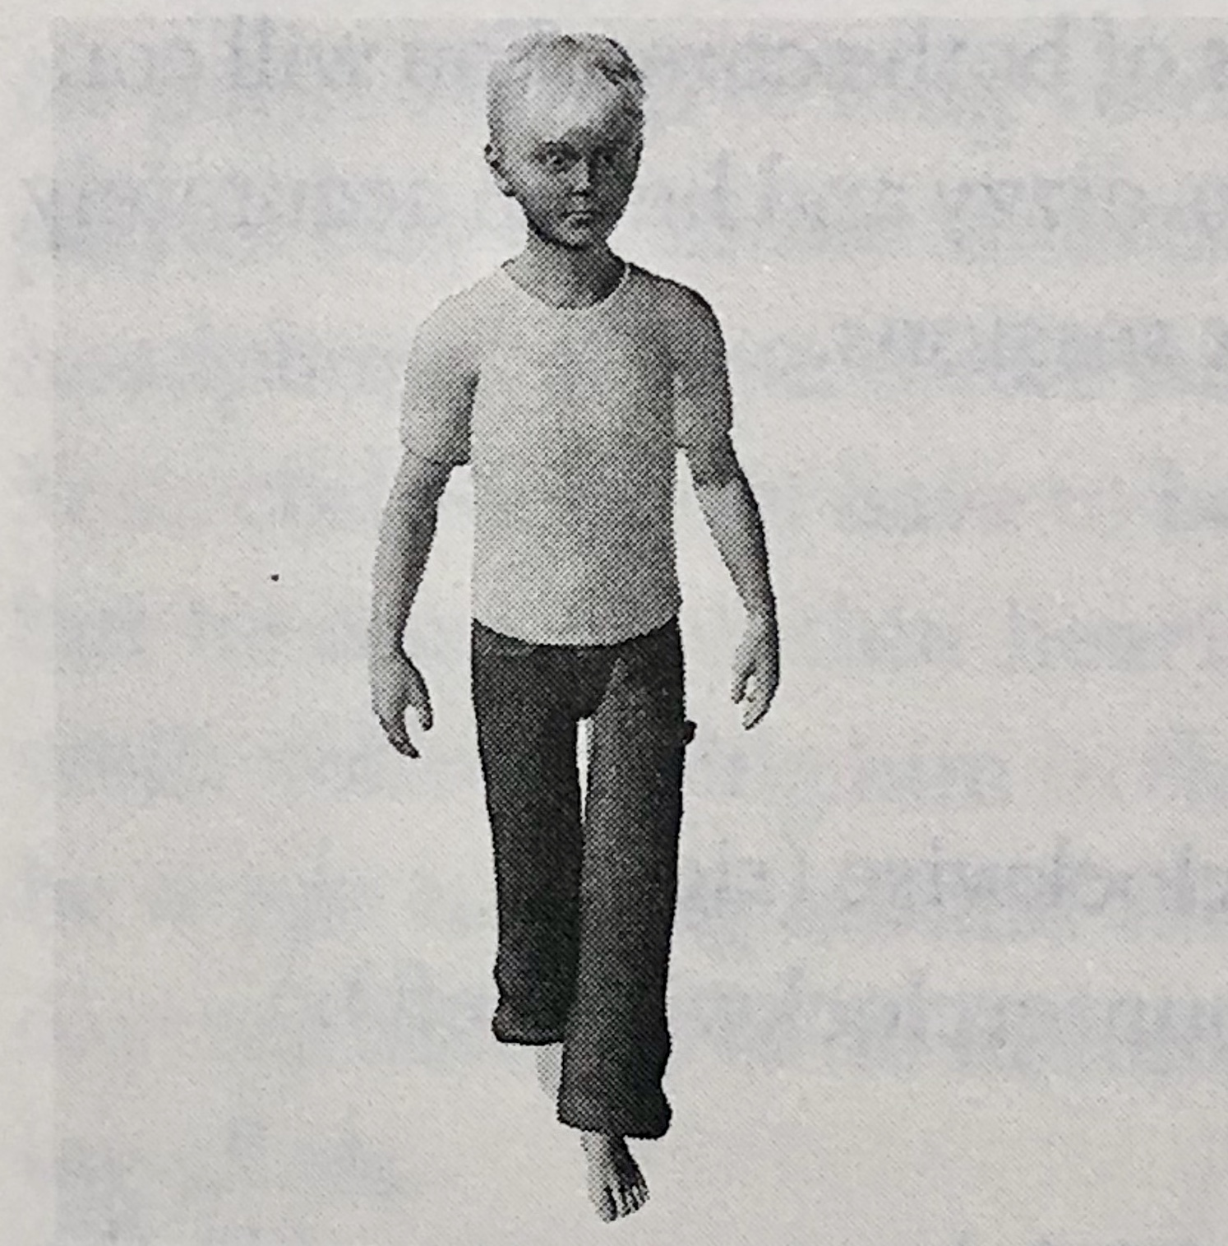
Proprioceptive Exercises: One foot in front of the other
Level: 1
One foot in front of the other- have the child remove the shoes and one sock. Have him remove the left sock if you want to stimulate the right hemisphere. Remove right sock if you are trying to stimulate the left.
Ask the child to stand straight, eyes open, with feet together, and move one foot directly in front of the other, as shown in the illustration.
The goal for the child to remain still for 30 seconds
When he can do this for 4 session in a row, move to Level 2

Slide 26
Proprioceptive Exercises: One Leg Stand
Level: 2
Right hemisphere deficiency: Bend right knee, Left brain deficiency: Bend left knee.
Have the child stand facing you with legs together and eyes open.
Ask him to ben his les as specified above and remain still as long as possible.
The goal is for the child to remain still in the position for 30 seconds.
When he can do this for 4 sessions in a row, go to Level 3

Slide 27
Proprioceptive Exercises: One Leg Stand
Level: 3
Take the same position as Level 2 but with eyes closed.
When an child ca remain perfectly still for 30 seconds for 4 sessions in a row, has achieved his goal.

Slide 28
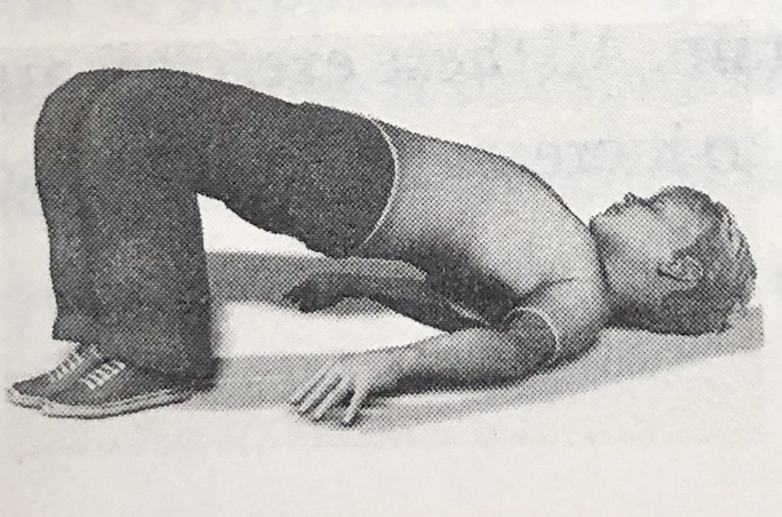
Supine Bridge Core Exercises
Level: 1
Have the child lie on her back with knees bent and feet flat on the floor shoulder width apart. Hands should be straight at the sides for support.
Help the child get off the ground by lifting her backside off the floor so that the spine is straight, as a form of bridge.
Do this exercise at each session until she can remain still in this position for 30 seconds. In older children, the goal is 60 seconds

Slide 29
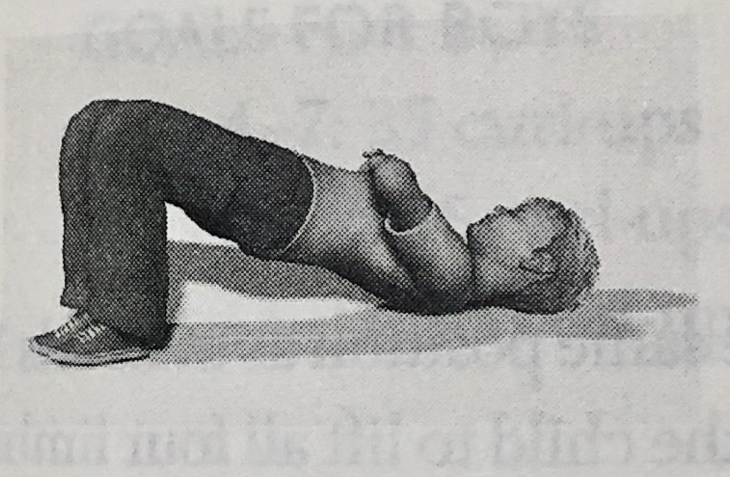
Supine Bridge Core Exercises
Level: 2
Have the child get in the same position as in Level 1 but the arms across his chest.
When he can maintain this position without buckling or moving for 60 seconds 4 sessions in a row , move to Level 3

Slide 30
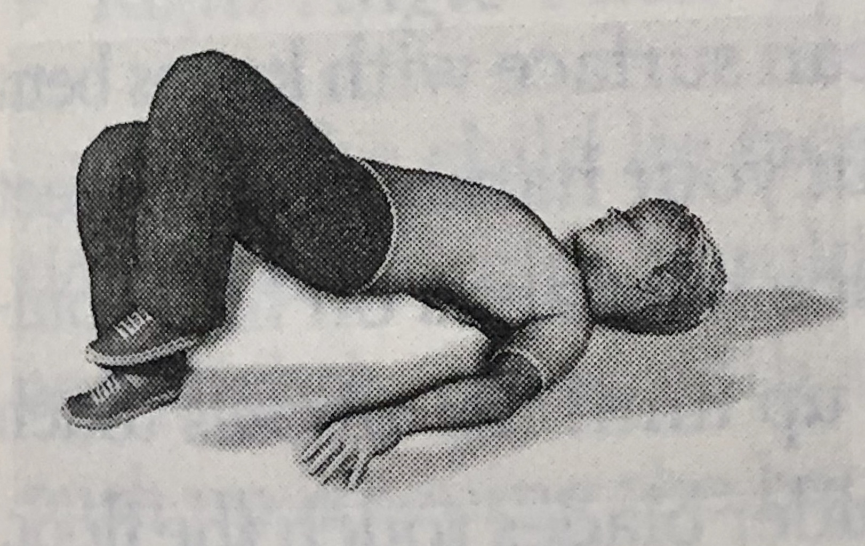
Supine Bridge Core Exercises
Level: 3
Have the child assume the same position as Level 1 and get into the bridge position.
Ask him to raise one leg off the ground about an inch or two and maintain this position for as long a possible, up to 30 seconds.
Switch legs and repeat.
The goal is to do this exercise until he can remain still in both potions without moving for 30 seconds or 4 sessions in a row

Slide 31
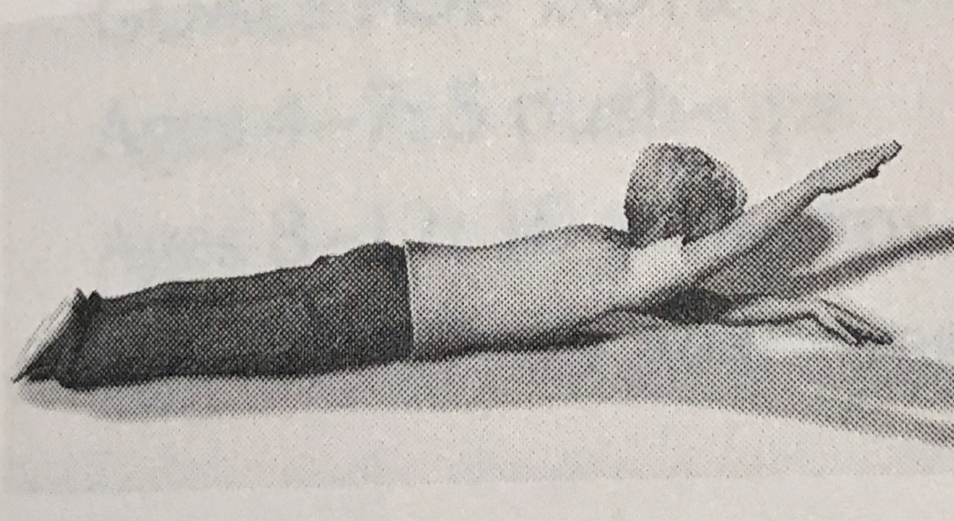
Prone Bridge Core Stability Exercise
Level: 1
Have the child lie down flat on her belly on the floor with arm straight out in front above her head.
Ask the child to raise her head and one arm off the floor and keep the arm perfectly straight.
Haver her hold this position as long as possible up to 15 seconds.
Repeat with the opposite arm and each leg.
When she can do this 4 sessions in a row, move to Level 2

Slide 32
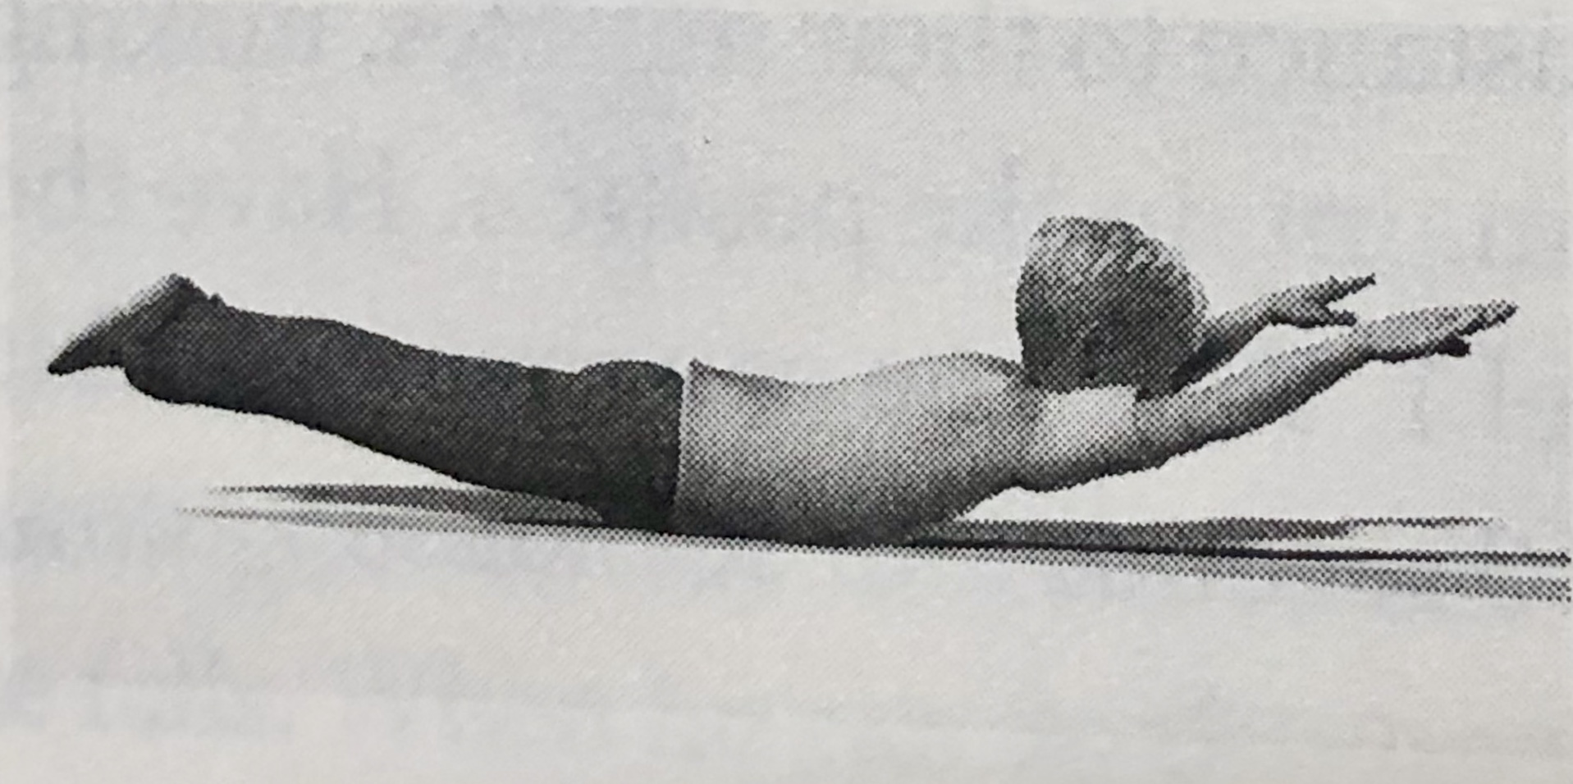
Supine Bridge Core Exercises
Level: 2
Repeat the same exercise as level 1 but aim for 30 seconds off the floor in both positions
When child achieves this for 4 sessions in a row move to level 3.

Slide 33
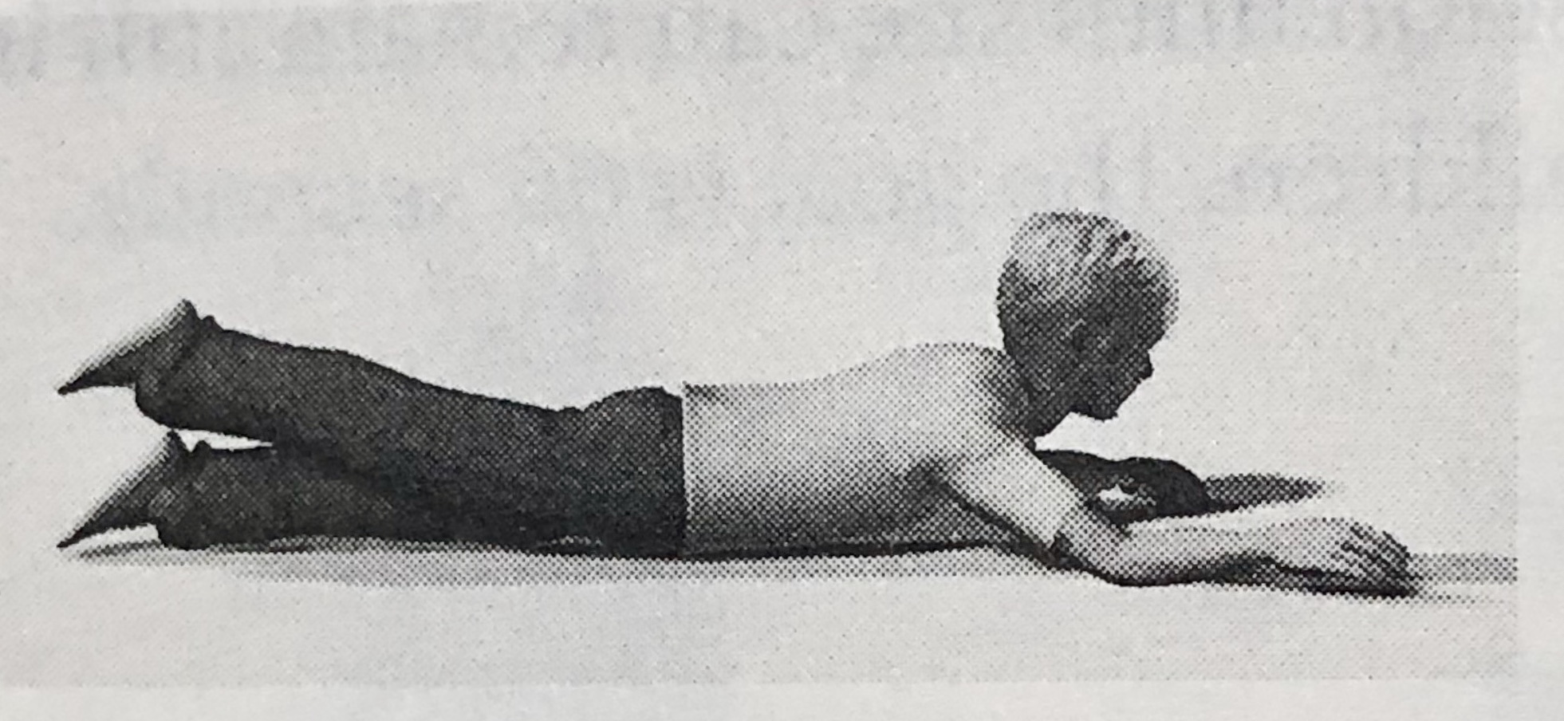
Supine Bridge Core Exercises
Level: 3
Assume the same position as in levels 1 and 2.
Ask the child to lift all four limbs off the floor for as long as possible.
The goal is to hold this position steady for 60 seconds 4 sessions in a row.

Slide 34
Curl-Ups (or Partial Curl-Ups) 1/3
Have the child lie on a flat cushioned surface with knees bent and feet about 12 inches from his backside.
Put your hands over his feet for support
Ask him to cross his arms and place his palms on his shoulders.
Now ask him to raise his trunk and curl up until his elbows touch his thighs.
Ask him to lay back down so the shoulder blades touch the floor, for one curl up.
Continue to do this for 1 minutes while counting aloud.
The goal is to do this fluidly for the number of times appropriate for their age and sex in one minute

Slide 35
Curl-Ups (or Partial Curl-Ups) 2/3
The goal is to do this fluidly for the number of times appropriate for their age and sex in one minute
Level 1: Goals for boys and girls
Ages 4-7 :15 curl-ups
Ages 8-12 :25 curl-ups
Ages 13-17: 35 curl-ups
Level 2: Goals for boys
Ages 4-7 :25 curl-ups
Ages 8-12 :35 curl-ups
Ages 13-17: 45 curl-up
Goals for girls
Ages 4-7 :25 curl-ups
Ages 8-12 :35 curl-ups
Ages 13-17: 40 curl-ups

Slide 36
Curl-Ups (or Partial Curl-Ups) 3/3
Level 3: Goals for boys
Ages 4-7 :35 curl-ups
Ages 8-12 :45 curl-ups
Ages 13-17: 55 curl-up
Goals for girls
Ages 4-7 :35 curl-ups
Ages 8-12 :45 curl-ups
Ages 13-17: 50 curl-ups

Slide 37
Right Angle Push-Ups 1/4
Have the child lie facedown on the floor in the classic push-up position: hands under shoulders, singers straight, and legs straight, parallel and slightly apart with the toes supporting the feet.
Ask the child to push up, keeping the back and knees straight, and then lower the body until there is a 90- degree angle at the elbows.
Place your hand flat underneath her chest so when she comes back down to the floor, she touches you hand before pushing up again.
The entire excise should take 3 seconds.

Slide 38
Right Angle Push-Ups 2/4
The goal is to do this fluidly for the number of times appropriate for their age and sex.
Level 1:
Goals for boys
Ages 4-7 : 5 push-ups
Ages 8-12 : 10 push-ups
Ages 13-17: 15 push-up
Goals for girls
Ages 4-7 : 5 push-ups
Ages 8-12 : 10 push-ups
Ages 13-17: 15 push-ups

Slide 39
Right Angle Push-Ups 3/4
Level 2:
Goals for boys
Ages 4-7 : 5 push-ups
Ages 8-12 : 15 push-ups
Ages 13-17: 30 push-up
Goals for girls
Ages 4-7 : 5 push-ups
Ages 8-12 : 10 push-ups
Ages 13-17: 15 push-ups

Slide 40
Right Angle Push-Ups 4/4
Level 3:
Goals for boys
Ages 4-7 : 15 push-ups
Ages 8-12 : 25 push-ups
Ages 13-17: 45 push-up
Goals for girls
Ages 4-7 : 15 push-ups
Ages 8-12 : 20 push-ups
Ages 13-17: 25 push-ups

Slide 41
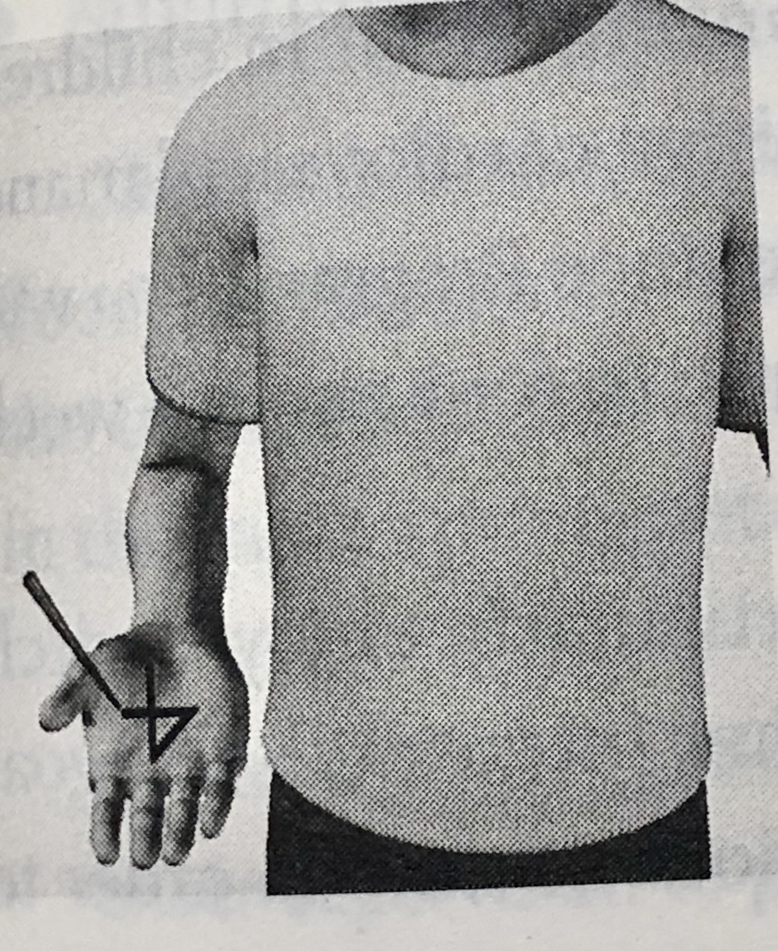
Tactile Exercises
Right hemisphere deficiency : Brush left side
Left hemisphere deficiency : Brush right side
Tactile Desensitization Activity: With a small brush the inside of the forearm and then the leg above the knee of appropriate side.
Number tracing exercise: Demonstrate this exercise prior to doing it.
Level 1: With eyes covered, have the child sit with arms outstretched and pals up. With the eraser end of pencil, trace a digit form 0 to 9 on the appropriate arm and ask him to identify numbers. When child can do this accurately for 4 sessions move on to Level 2
Level 2: Repeat 1 but write 6 random numbers. When he gets it accurately 3 times in a row, proceed to Level 3.
Level 3: Repeat Level 1 but 9 random numbers. When he gets it accurately 3 times in a row, you have reached the goal.
Number tracing Level 1

Slide 42
Aerobic Exercises
We now know that humans have the ability to reproduce brain cells through aerobic activities.
The link that between aerobic exercise and brain growth is oxygen.
In research studies running, biking, jumping jacks, jumping rope, and so forth, have proven to be highly effective in decreasing hyperactivity as well as increasing focus and concentration in children diagnosed with ADHD.
As part of the Brain Balance program, you will have your child do an aerobic activity at lease 3 to 4 times a week but preferably every day.

Slide 43
Aerobic Exercises 1/3
Running in place
Mark an X of the floor.
Demonstrate for your child how to run in place, moving the arms and legs. Remember , controlled movement is very important.
Start 1 minute followed by a 1 minute rest.
Only when the child can run in place smoothly in a good rhythm, slowly increase the time 1 minute at a time.
As your child improves, continue to integrate mental exercises such as saying the alphabet, numerical operations or even making up a story verbally with the aerobic exercise.

Slide 44
Aerobic Exercises 2/3
Jumping
Have your child jump up and down on the X for 30 seconds, followed by a 30 second rest. Increase the time in increments of 30 seconds as the child is able.
Minitrampoline
Since controlled movement is the key, mark an X in the center of the trampoline and have the child attempt to be accurate about jumping in the same spot repetitively.
Jumping Rope
Have the child jump unassisted for 1 minute, followed by 1 minute rest. Increase increments of 1 minute at a time.
If the child is unable to jump unassisted, you can tie a long jump rope to a fence of doorknob and turn the rope for him.

Slide 45
Aerobic Exercises 3/3
Running
Children love to run, especially when you make a game out of it.
Set up a course in the yard with cones or objects which the child can run through or around. Use your imagination.
Jumping jacks
Show the child how to get in position with the feet together and arms at the side. Jump up and simultaneously raise the arm and spread the legs on the descent.
Have the child do 20 jumping jacks in a row, followed by a 15 seconds rest. Do a total of 3 sets.
Once the child mastered this, repeat with the child’s eyes closed.

