Slide 1
Training for Parents
Behavior management

Slide 2
What is behavior?
Behavior is defined as anything a person does.
Some behaviors can be increased and some can not.
Some behaviors can be decreased and some can not.
It takes a lot of time and work to increase or decrease a behavior that is not innate or previously learned.

Slide 3
Activity
Cross your arms
Switch
Process
Now do this for the rest of your life

Slide 4
Behaviors
What comes to mind when you hear the term “behavior?”
Think of some behaviors
What defines a “positive” behavior?
What defines a “maladaptive” behavior?
Environmental Factors
Individual Learner Capabilities
Social Appropriateness
Applied Behavior Analysis: Behavior analysis is the science of behavior, with a history extending back to the early 20th century. Its underlying philosophy is behaviorism, which is based upon the premise that attempting to improve the human condition through behavior change (e.g., education, behavioral health treatment) will be most effective if behavior itself is the primary focus. (Behavior Analyst Certification Board)

Slide 5
Behavior
Behavior: The activity of living organisms in relationship to the organisms’ environment.
2 Types of Behavior:
Respondent
Elicited or triggered by antecedents
Operant
Determined by history or past events
Activity
This is the function or antecedent for their behavior.
Notes:
Ask about a time when they cried, laughed, screamed, grind your teeth, burrow your frow
Write down examples
Ask why did they feel this way…
This is the function or antecedent for their behavior.

Slide 6
Functions of behavior
Every behavior has a function
What does this mean?
A function of a behavior is knowing what causes the behavior. What is the reason the behavior is occurring. What does the person want or need that is causing the behavior.
Whether the motive is attention, an emotion, an edible (food), or even an aversion (fear), there are 4 main functions of behaviors.

Slide 7
Functions
The first step to delivering wants/needs to your child is to isolate the function of their behavior.
Example: Tommy is aggressing (hitting) mother due to desire for attention.
Now that we have determined the function (need or desire)we can teach them a more appropriate method, or replacement, to gain access to the need or desire.
You can teach them to ask, to point, to give a picture.

Slide 8
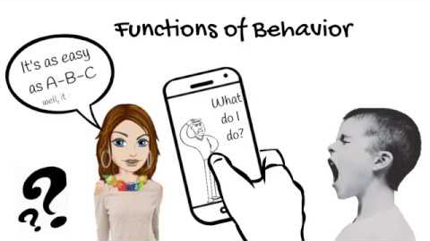

Slide 9
REPLACEMENT STRATEGIES TO REDUCE PROBLEM BEHAVIORS
TASK MODIFICATIONS
GIVE CHOICES
PROMPTING
PROVIDE CONTINGENT ATTENTION
DIFFERENTIAL REINFORCEMENT
PROVIDE FIRST/THEN CONTINGENCIES

Slide 10
TASK MODIFICATION
Entails modifying some aspect of a task to reduce the aversiveness and/or cognitive load associated with a particular task, which may assist with improved learning of the concept at hand.

Slide 11
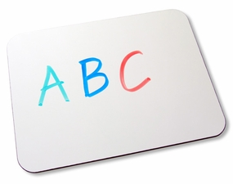
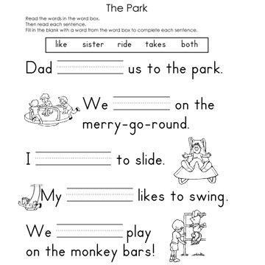
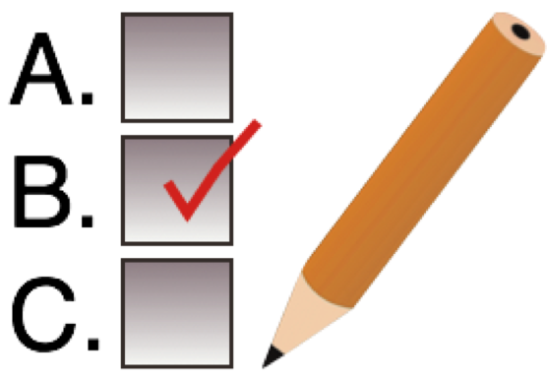
TASK MODIFICATION EXAMPLES

Slide 12
Give choices
Antecendent interventions
Giving a choice (controlled choice)
Ex: do you want to go to the bath now or in 2 minutes. You choose.

Slide 13
Scenarios: Your Turn!
Jane walks into the grocery store with her parent. She sees the ice cream section, points, and says “I want ice cream.” The mother says, “Jane, no ice cream today.” Jane starts to scream loudly and others in the store start looking in their direction. Jane’s mother does not take Jane grocery shopping again for a long time.
Think about… ANTECEDENT? BEHAVIOR? CONSEQUENCE? FUNCTION? REPLACEMENT BEHAVIORS? What could the parent have done differently in this scenario?

Slide 14
Scenarios: Your Turn!
Kyle just completed a puzzle. Kyle notices his father look at his cell phone. He pinches his father sitting next to him. The father says, “Ouch! That hurt! Kyle don’t pinch me!” Kyle pinches his father once more. The father says, “No pinching!” Kyle becomes frustrated and throws puzzle pieces into the air. The father then says, “Kyle, pick up those puzzle pieces!”
ANTECEDENT? BEHAVIORS? CONSEQUENCE? REPLACEMENT BEHAVIORS? What could the parent have done differently in this scenario?

Slide 15
Scenarios: Your Turn!
Leila is reading with her father, who believes that Leila should be reading at a higher level than she is currently. Leila reads one sentence, but misses several words. The father becomes agitated and says, “Leila, you need to practice your reading words! You keep missing the same ones!” Leila begins to twirl her hair tightly around her finger. They keep reading. Leila continues to miss words. Leila’s father continues to reprimand. Leila twirls her hair even tighter around her finger. Leila continues to twirl tighter and tighter until her fingers tingle.
ANTECEDENT? BEHAVIORS? CONSEQUENCES? REPLACEMENT BEHAVIORS? What could the parent have done differently?

Slide 16
Scenarios: Your Turn!
Robert’s mother asks him to eat his salad. Robert immediately starts banging on the dinner table. The mother takes the salad plate away, and Robert does not have to eat the salad. Instead, Robert’s mother brings out his favorite meal of macaroni and cheese.
ANTECEDENT? BEHAVIOR? CONSEQUENCE? REPLACEMENT BEHAVIOR? What could the parent have done differently?

Slide 17
Why do behaviors happen?
Problem behavior serves a purpose
Observable behaviors mask deficits
Treat functions (why) and not the behavior (manifestations)
Teach replacement skills that serve the same function
Modify antecedents (triggers) and consequences (responses from others)
Use proactive and not only reactive strategies
Always use positive behavior intervention supports
Behaviors can escalate or change before improving

Slide 18
Attention
When does this Behavior occur?
Behavior occurred when child was being ignored or when parents were paying attention to others.
Why does this Behavior occur?
When Behavior occurs, Parents talk to or tries to calm the child down.
What should I do?
Remain calm and appear not to be bothered by the behavior.
Ignore the attention-seeking behavior with a neutral facial expression or look away.
When the child is behaving appropriately, provide attention.
Provide an alternative and functional way for the child to gain attention and reinforce it consistently.

Slide 19
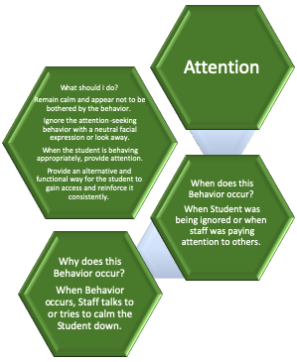

Slide 20
Tangible
When does this Behavior occur?
When child was denied preferred item or preferred activity was taken away.
Why does this Behavior occur?
parent calms child down by giving preferred activity or preferred item.
What should I do?
Remain calm and emotionally neutral (calm tone of voice, limited eye contact.)
If child gains access to tangible item, end access by immediately removing item.
Prevent access of tangible while child is demonstrating problem behavior.
Provide waiting time so child’s behavior doesn’t prompt people in environment to give tangibles.
Use a contingent situation where child can earn access to tangibles, upon appropriate behavior or absence of problem behavior.

Slide 21
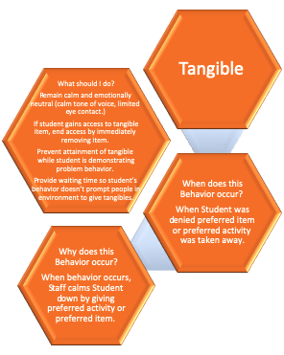

Slide 22
Escape
When does this Behavior occur?
Behavior occurred when child was presented with task or asked to do something.
Why does this Behavior occur?
When Behavior occurs, parent gives child a break from task or something asked to do.
What should I do?
Remain calm and emotionally neutral (calm tone of voice, limited eye contact.)
The problem behavior should not cause the parent to show any frustration.
Ignore the problem behavior if possible.
Continue with the situation or demand that existed prior to the occurrence of problem behavior.
Reinforce small successes to establish or build work momentum or engagement.

Slide 23
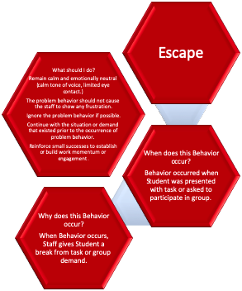

Slide 24
Automatic
When does this Behavior occur?
Behavior occurred when child had access to tangible and attention and no demands were made on the child.
Why does this Behavior occur?
Whether parent did anything or not, Behavior provides sensory stimulation or is ritualistic and occurs in the same way.
What should I do?
Remain calm and emotionally neutral (calm tone of voice, limited eye contact.)
Interrupt child’s stereotypic behavior with appropriate replacement behavior.
Keep child engaged with task.
Stay near child to facilitate easier access to redirection or prevention.
Reinforce child for on-task behavior (work or play)

Slide 25
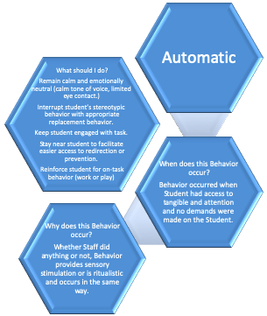

Slide 26
What does my child need?
#1 Social Attention
A child will engage in a certain behavior to gain some form of social attention or a reaction from other people. For example, a child might engage in a behavior to get other people to look at them, laugh at them, play with them, hug them or scold them.
While it might seem strange that a person would engage in a behavior to deliberately have someone scold them it can occur because for some people it’s better to obtain “bad” attention than no attention at all (Cooper, Heron & Heward, 2007).
#2 Tangibles or Activities
Some behaviors occur so the child can obtain a tangible item or gain access to a desired activity. For example, a child might scream and shout until their therapist gives them a cookie (tangible item) or bring them to the zoo (activity).

Slide 27
#3 Escape or Avoidance
Not all behaviors occur so the child can “obtain” something; many behaviors occur because the child wants to get away from something or avoid something altogether (Miltenberger, 2008).
For example, a child might engage in aggressive behavior so his teachers stop running academic tasks with him or another child might engage in self-injury to avoid having to go take a bath.
#4 Sensory Stimulation
The function of some behaviors do not rely on anything external to the child and instead are internally pleasing in some way – they are “self-stimulating” (O’Neill, Horner, Albin, Sprague, Storey, & Newton, 1997). They function only to give the child some form of internal sensation that is pleasing or to remove an internal sensation that is displeasing (e.g. pain).
For example, a child might rock back and forth because it is enjoyable for them while another child might rub their knee to sooth the pain after accidentally banging it off the corner of a table. In both cases, these children do not engage in either behavior to obtain any attention, any tangible items or to escape any demands placed on them.

Slide 28
What is Reinforcement?
Positive Reinforcement
The presentation of a reinforcer following the behavior, which increases the future probability of the behavior
A stimulus is added following the behavior
Negative Reinforcement
The removal or avoidance of a stimulus following the behavior, which increases the future probability of the behavior
A stimulus is removed following the behavior
Reinforcement always increases the rate of the behavior (if your reinforcement procedure is not increasing a behavior, it is not working as a reinforcer!)

Slide 29
Examples
Positive Reinforcement:
Eg: Cathy blows bubbles after her client appropriately says or signs for “Bubbles!”
Negative Reinforcement:
Eg: Joe does not like wearing his soccer jersey. He takes it off whenever his mom tries to get him to wear it for his soccer games. Mom notices the jersey has a large tag on the neck, and she removes it. Once tag is removed Joe wears his jersey with no problem to all soccer games.

Slide 30
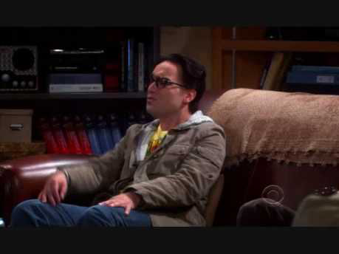
Notes:
Positive reinforcement. Stop video at 1:28

Slide 31
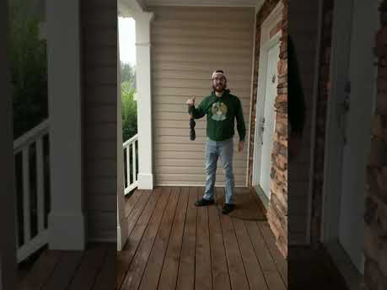

Slide 32
REINFORCEMENT GUIDELINES
Ensure that you have a variety of reinforcers
Make contingent (earned) & also give’ freebies’!
Might lose value over time
Pair tangibles with social reinforcement (praise)
What you deliver- make sure it is actually desired by the child
When you deliver- Immediate – develop relationship between behavior and reinforcer (should be delivered within 3 sec of the desired behavior)
How often you deliver – schedule or rate
Amount that you deliver – magnitude
Differential reinforcement (vary when you deliver)
New tasks (or) more difficult tasks should result in better reinforcement
Do Not reinforce for completion only.

Slide 33
What is Punishment?
Positive Punishment
A stimulus that immediately follows a behavior, which decreases the future probability of that behavior occurring in the future (e.g., a reprimand, touching something hot and feeling pain)
Negative Punishment
A stimulus that is immediately removed following a behavior, which decreases the probability of that behavior occurring in the future (e.g., taking away computer time)
Punishment always decreases the rate of the behavior. If the behavior is not decreasing, you are not providing punishment

Slide 34
PROBLEM BEHAVIORS
Punishment procedures are used to decrease problem behaviors
The term ‘punishment’ is not what you think it is ie: spanking, timeout
A ‘punisher’ is anything that aids in decreasing a behavior. So, if ‘time out’ is used when a child hits, but the child continues to hit on a regular basis, then ‘time out’ would not be considered a punisher since the problem behavior is not decreasing.

Slide 35
How are my child’s needs being met?
#1 Social Attention: My child gets his social attention needs met by: ____________________________________________________________________________________________________________________________________________________________________________________________________________________________________

Slide 36
How do I want my child’s needs to be met?
#1 Social Attention: I want my child to get his social attention needs met by: ____________________________________________________________________________________________________________________________________________________________________________________________________________________________________

Slide 37
How are my child’s needs being met?
#2 Tangibles or Activities: My child gets access to items/food & activities by: ____________________________________________________________________________________________________________________________________________________________________________________________________

Slide 38
How do I want my child’s needs to be met?
#2 Tangibles or Activities: I want my child to get access to items/food & activities by: ____________________________________________________________________________________________________________________________________________________________________________________________________________________________________

Slide 39
How are my child’s needs being met?
#3 Escape or Avoidance: My child avoids and gets away from things he doesn’t like by: ____________________________________________________________________________________________________________________________________________________________________________________________________

Slide 40
How do I want my child’s needs to be met?
#3 Escape or Avoidance: I want my child to avoid and get away from things he doesn’t like by: ____________________________________________________________________________________________________________________________________________________________________________________________________________________________________

Slide 41
How are my child’s needs being met?
#4 Sensory Stimulation: My child meets his need for pleasing sensory stimulation by: ____________________________________________________________________________________________________________________________________________________________________________________________________

Slide 42
How do I want my child’s needs to be met?
#4 Sensory Stimulation: I want my child to meet his need for pleasing sensory stimulation by: ____________________________________________________________________________________________________________________________________________________________________________________________________________________________________

Slide 43
Activity
Take a piece of black paper
Take a pencil
Think of the times your child has done something that was inappropriate, aggravating, frustrating, etc. For each instance you think of, poke the paper with your pencil.
When you are done, hold your paper up to the light.
What do you see?

